Slide 1
Super-resolution
Optical Fluctuation Imaging
(SOFI)
Dertinger, T., Colyer, R., Iyer, G., Weiss, S., & Enderlein, J. (2009).
Fast, background-free, 3D super-resolution optical fluctuation imaging (SOFI).
Seyoon Park
Notes:
Hello everyone. My name is Seyoon Park.
Today I will present ‘Super-resolution Optical Fluctuation Imaging’ author by Dertinger et al.

Slide 2
Microscope technologies which overcome diffraction limit have been developed, but they have some limitations
Technology | Pros | Cons
STED | Achieve Video Rate | Tedious alignment procedure
PALM / STORM | Nanometer resolution | Slow acquisition speed
SIM | Fast 3D image | Fixed cell, High Intensity
OLID | Fast Imaging, Enhance Contrast | Lack super-resolution capability
Super-resolution
methods
Expense of major technical demands Modifications to the microscope
1 / 20
Notes:
In recent decades, microscopy technologies have been developed rapidly.
Especially several super-resolution methods have been developed and overcome the fundamental diffraction limit of light.
As you see in the table, each methods has different disadvantages.
STED method can achieve video rate but it has quite demanding in labeling procedures and tedious alignment procedure.
PALM/STORM methods can get nanometer resolution image but the acquisition speed is slow.
SIM method can get fast 3D image but it can take only fixed cell image and high intensity problem.
OLID method can achieve fast imaging and enhance the contrast of image but it lacks super-resolution capability.
Above all, those super-resolution methods requires technical expense or modifications to microscope

Slide 3
Advantages and benefits of SOFI technique
Overcome diffraction limit
Generate virtually background-free
Contrast-enhanced image
Can be applied to any kind of fluorescence imaging methods
Don’t need for sophisticated electronics
2 / 20
Notes:
Comparing to previous microscopy methods, this paper introduce 3D super-resolution method that overcomes previous limitations.
SOFI method not only overcomes the diffraction limit but also generate virtually background-free and contrast enhanced images with a few seconds of acquisition time.
Also it can be applied to any kind of fluorescence imaging methods and doesn’t need for sophisticated electronics.

Slide 4
SOFI technique is an analysis of temporal fluorescence fluctuations of emitters
SOFI (Super-resolution Optical Fluctuation Imaging)
Take Images by Time Series
Filter Signal by n-th order cumulant
Super-resolution
Contrast enhance
Highly correlated fluctuations are left over
3 / 20
Notes:
Simply, SOFI method relies on higher-order statistical analysis of temporal fluctuations recorded in a sequence of images.
Therefore, the method was named as ‘Super-resolution Optical Fluctuation Imaging’.
The analysis of fluorescence fluctuation can be explained to 3 steps.
First step is taking images by time series. And second step is filtering the signal by n-th order cumulant which will be explained in theoretical part. And there will be left only highly correlated fluctuation information.
From these steps, SOFI method can overcome diffraction limit and get contrast enhanced image.

Slide 5
3 Conditions for SOFI image processing
1. Fluorescent label
At least 2 different emission states
2. Emitters
Switch between states repeatedly and independently from each other
3. Image pixel
The image should be acquired with pixels smaller than the diffraction limit
4 / 20
Notes:
For analyzing fluorescence fluctuation of the image, there are three conditions.
First condition is about Fluorescence label. The fluorescence should have at least 2 different emission states.
Second condition is emitter. Different emitters should switch between states repeatedly and independently from each other.
Last condition is image pixel. The image should be taken with pixels smaller than the diffraction limit.

Slide 6
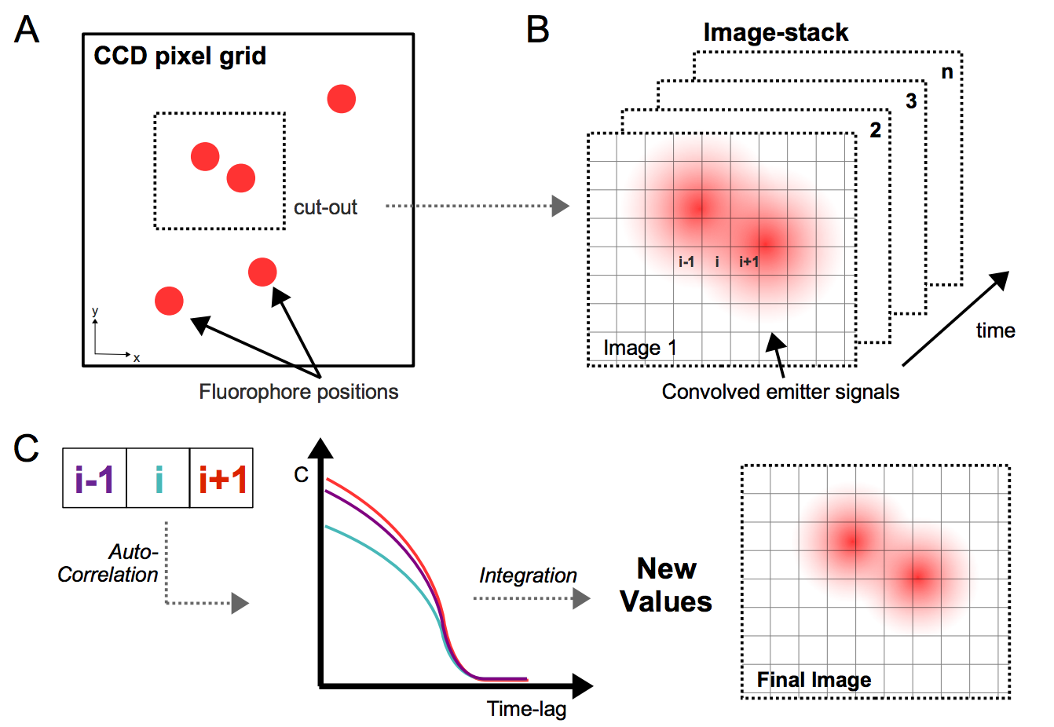
Improving image resolution procedure of SOFI
5 / 20
Notes:
Let’s begin to see the pic picture of SOFI method procedure.
Picture A show us fluorophore positions in CCD pixel grid. There may be in close distance so positions cannot be separated in image distinctly.
The signal from the emitter fluorescence distribution is convolved with the system PSF and recorded on a subdiffraction grid in Picture B.
The signals of each pixel have fluctuations by time series.
Next stage is auto-correlation of each pixel fluctuation signal. So it can achieve highly correlated signal than before. You can see smooth graph in picture C.
This part will be specifically explained in following slides.
At last stage the SOFI intensity value is given by the integral over the auto correlation function.

Slide 7
Main theoretic process is creating cumulant equation for computing SOFI image
Auto-correlation
Fluorescence Signal Process
2nd order auto-correlation function G₂
New “PSF” from G₂ & n-th order effect
Cumulant Function C_{n}
6 / 20
Notes:
As I mentioned in previous slide, the main part is processing fluctuations of fluorescence signal.
The result of this part is achieving Cumulant function Cn which can enhance the image resolution from previous fluctuating low resolution image.
I will introduce you how to deduce the cumulant function in four stages.
It will start from understanding fluorescence signal.
And next stage will explain about the result of 2nd order auto-correlation of fluorescence signal
From the auto correlation function, it will achieve new PSF function and expand it to higher order case.
The last stage it will get the cumulant function for SOFI processing.

Slide 8
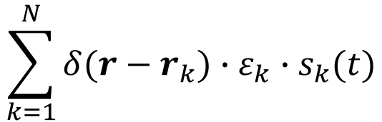
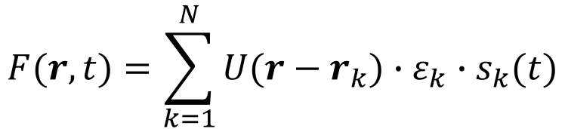
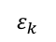
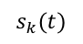
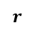
Step 1 - Fluorescence Signal Process
Fluorescence Source Distribution
$$\sum_{k=1}^{N}{δ(r−r_{k})∙ε_{k}∙s_{k}(t)}$$
$$r$$
Position
$$ε_{k}$$
Constant Molecular Brightness
$$s_{k}(t)$$
Time-dependent fluctuation
Fluorescence Signal
(Convolution of PSF U(r) and Fluorescence Source Distribution)
$$F(r,t)=\sum_{k=1}^{N}{U(r−r_{k})∙ε_{k}∙s_{k}(t)}$$
Fluorescence Signal
7 / 20
Notes:
We will begin to understanding about fluorescence signal process.
Given sample composed of N single, independently fluctuating emitters will result fluorescence source distribution. Each fluorescence source is deteremined by position r, brightness e, and time dependent fluctuation 나
With convolution of PSF U(r) we can get fluorescence signal F(r,t). You can see the example of this signal on the right side picture. We can observe the signal is fluctuating by time changes.

Slide 9
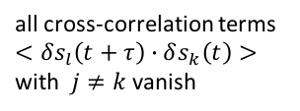
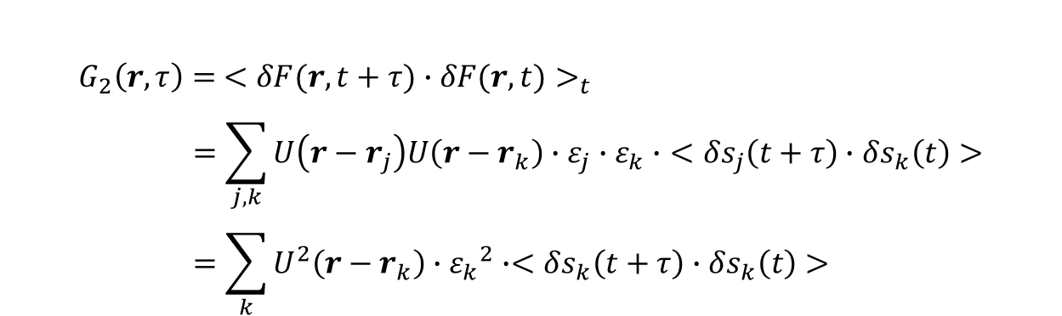
Step 2 - 2nd order auto-correlation function G₂
$$G_{2}\left(r,τ\right)={ <δF(r,t+τ)∙δF(r,t)>}_{t} \\ =\sum_{j,k}{U\left(r−r_{j}\right)U\left(r−r_{k}\right)∙ε_{j}∙ε_{k}∙}<δs_{j}\left(t+τ\right)∙δs_{k}\left(t\right)> \\ =\sum_{k}{U^{2}\left(r−r_{k}\right)∙{ε_{k}}^{2}∙<δs_{k}\left(t+τ\right)∙δs_{k}\left(t\right)> }$$
all cross-correlation terms
$<δs_{l}\left(t+τ\right)∙δs_{k}\left(t\right)>$
with $j≠k$ vanish
Emission of different emitters
not correlated in time
PSF is replaced by square of the original PSF
8 / 20
Notes:
Next step is auto-correlation process.
If we do 2nd order auto correlation to fluorescent signal we achieve from previous step, we can get the final equation.
From second step to final step the different position j, k terms was removed.
This is because emission of different emitters are not correlated each other in time.
As you see above picture, the auto-correlation signal shows stable signal.
Finally, we could achieve new PSF which is square of the original PSF.
This effect will be explain in the next slide.

Slide 10
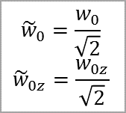
Step 3 - New “PSF” from G₂ & n-th order effect
PSF from 2nd order auto-correlation G₂
Original PSF
New PSF
$${\tilde{w}}_{0}=\frac{w_{0}}{\sqrt{2}}$$
$${\tilde{w}}_{0z}=\frac{w_{0z}}{\sqrt{2}}$$
$$U\left(r\right)=\exp\left(−\frac{x^{2}+y^{2}}{2{w_{0}}^{2}}−\frac{z^{2}}{2{w_{z0}}^{2}}\right) ⇒ U^{2}\left(r\right)=exp⁡(−\frac{x^{2}+y^{2}}{2{{\tilde{w}}_{0}}^{2}}−\frac{z^{2}}{2{{\tilde{w}}_{z0}}^{2}})$$
New PSF is reduced by a factor of $\sqrt{2}$ along all 3 dimension
Increase optical resolution of 2nd order SOFI Image
Higher-order correlation functions generate higher powers of PSF and increase resolution
n-th order of PSF → resolution is enhanced by a factor $\sqrt{n}$
9 / 20
Notes:
From the last equation of 2nd order auto-correlation function G2, we got a new PSF.
The new PSF which is square of the original PSF is reduced by a factor of square root two along all three dimensions.
This means that 2nd order SOFI image can achieve square root two fold increased resolution.
Therefore, higher order auto correlation functions will generate higher powers of PSF and able to increase image resolution.
N-th order PSF will enhance resolution image by a factor square root n.

Slide 11
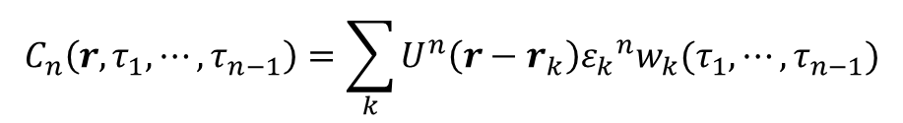
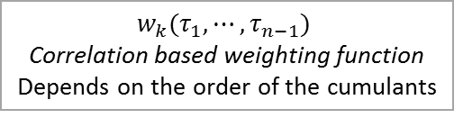

Step 4 - Cumulant Function C_{n}
n-th order correlation function Gn
$$G_{n}\left(r,τ_{1},⋯,τ_{n−1}\right)={<δF(r,t)δF(r,t+τ_{1})⋯δF(r,t+τ_{n−1})>}_{t}$$
To generate SOFI images of higher orders, necessary to transform the n-th order correlation functions into n-th order cumulant functions
Cumulant Function C_{n}
$$C_{n}\left(r,τ_{1},⋯,τ_{n−1}\right)=\sum_{k}{U^{n}\left(r−r_{k}\right){ε_{k}}^{n}w_{k}(τ_{1},⋯,τ_{n−1})}$$
$w_{k}(τ_{1},⋯,τ_{n−1})$
Correlation based weighting function
Depends on the order of the cumulants
All cross terms caused by lower-order are eliminated in cumulants
New n-th order PSF $U^{n}$ could be acquired
10 / 20
Notes:
Expanding 2nd auto-correlation function to n-th order auto-correlation function Gn can be expressed to the first equation.
But it should be transformed to nth-order cumulant function for generating SOFI images of higher orders
The reason is that all cross terms caused by lower order correlation are eliminated in cumulants, so that nth order cumulant consists only of terms containing the nth power of the PSF.
Because the nth-order cumulant generates an image effective PSF that is nth power of the original PSF, the resolution is enhanced by a factor square root n.
Therefore, 4th order cumulant will result 2-fold resolution, 16th order cumulant will result 4-fold resolution enhancement.

Slide 12
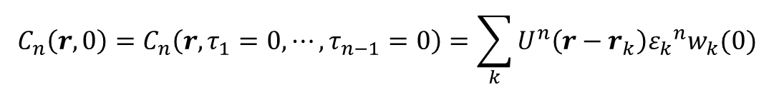
Practical way to compute SOFI image is setting all time lags to zero in cumulant function C_{n}
Limiting factor for generation of higher order SOFI images
n-th order cumulant
The computation time and memory increase n²
In practice, setting all time lags to zero for computing SOFI image most efficiently
$$C_{n}\left(r,0\right)=C_{n}\left(r,τ_{1}=0,⋯,τ_{n−1}=0\right)=\sum_{k}{U^{n}\left(r−r_{k}\right){ε_{k}}^{n}w_{k}(0)}$$
11 / 20
Notes:
There will be no fundamental difficulty in computing higher-order cumulant.
However, the computation time and memory will be increased as n squared.
This may be rapidly become a limiting factor of generation higher order SOFI image.
Therefore, in practice, the most efficient to compute SOFI images is setting all time lags to zero.
So cumulant Cn can be expressed as the simplified form in the slide equation.

Slide 13
Experiment 1 – Quantum Dots
Resolution enhanced by higher order SOFI cumulant
Original
2nd
4th
9th
16th
25th
12 / 20
Notes:
The first experiment was image of Quantum dots deposited on a coverslip.
The distance between two quantum dots is less than diffraction limit. So you can observe the original image which seems just as one quantum dot.
But processing the image stack of original by SOFI method, the resolution become increased
So you can observe separate quantum dots more clearly as the order of SOFI cumulant increased.

Slide 14
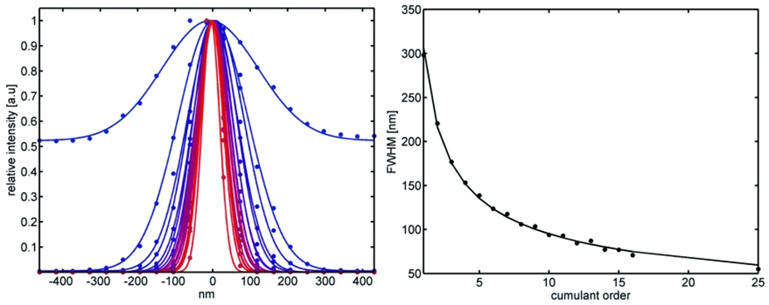
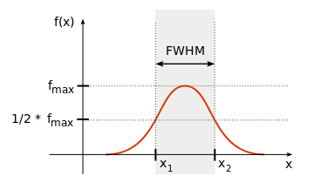
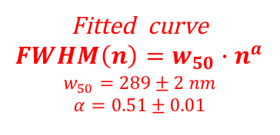
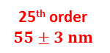
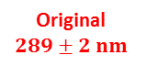
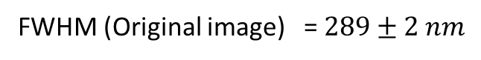
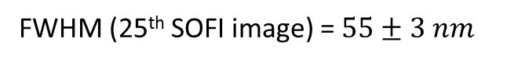
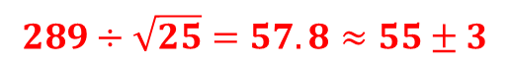
Experiment 1 – Quantum Dots
Intensity of cross section reduced by higher order
Original
$$289±2 nm$$
Fitted curve
$$FWHM\left(n\right)=w_{50}∙n^{a}$$
$$w_{50}=289±2 nm$$
$$α=0.51±0.01$$
25th order
$$55±3 nm$$
(FWHM : Full width at half maximum)
FWHM (Original image) = $289±2 nm$
$$289÷\sqrt{25}=57.8≈55±3$$
FWHM (25th SOFI image) = $55±3 nm$
5 fold enhancement Confirm
13 / 20
Notes:
In this slide, you can see the instensity graph of one of quantum dots.
The relative intensity graph getting narrower as the order of cumulant become higher.
Also comparing the signal-to-background ratio of the original image with the second order SOFI image, they observe a striking 130 fold improvement.
We could create FWHM graph which means full width at half maximum from the relative intensity graph.
The fitted line of FWHM line follows power law.
As you see the values of original image and 25th order SOFI image, the FWHM value is different with 5 fold.
So we could confirm that the theoretic resolution enhancement from this value.

Slide 15
Rendered SOFI 3D PSFs are shrinking along all three axes at higher orders
16th order PSF
4th order PSF
3rd order PSF
2nd order PSF
Original PSF
14 / 20
Notes:
To prove resolution enhancement in three dimensions, they performed 3D scan through a single Quantum dot.
Movies were recorded for different image planes.
The smoothed iso surfaces was rendered as a 3D images.
In this picture you can confirm that SOFI’s PSF are shrinking along all three axes at higher order.
From outer surface to inner surface, the order changes from 2nd, 3rd, 4th, and 16th.

Slide 16
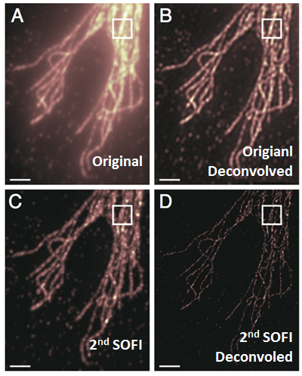
Experiment2 - α-tublin network of a 3T3 fibroblast cell
Resolution enhanced by higher order SOFI cumulant
15 / 20
Notes:
Next experiment was α-tublin network of a 3T3 fibroblast cell
Comparing picture A and C, it enhance the resolution and also striking enhancement in Signal to Background noise ratio is apparent.
In optics and imaging, deconvolution is the process of reversing the optical distortion, simply creating clearer images.
In this experiment, they confirmed that deconvolved image of original is comparable with 2nd SOFI image.
And deconvolved image of 2nd SOFI image was noticeably better. This is because deconvolution algorithm tend to operate better if no background is present.

Slide 17
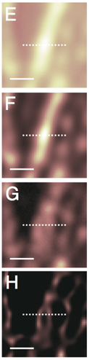
Experiment2 - α-tublin network of a 3T3 fibrobalst cell
2nd order SOFI image can be deconvolved noticeably better
Original
Deconvoled
(Original)
E
F
2nd SOFI
G
Deconvoled
(2nd SOFI)
H
16 / 20
Notes:
From previous image, they observed an intensity profile of cross section.
In the case of original and original deconvolution, we cannot observe separation, there are only one peak value in the graph.
However, in 2nd SOFI graph, we can observe 2 peak values. And the peak became distinct in the image of 2nd SOFI deconvolution case.
Finally we could confirm that the SOFI method improves image better than deconvolution, and also it was noticeably improved with deconvolution algorithm.

Slide 18
SOFI is comparative advantages in super-resolution, simplicity approach, and undemanding requirements
Similarity is origin in common mathematical concept of correlation functions
STICS (Spatiotemporal Image Correlation Spectroscopy)
Analogy in formulas, both methods use image series and temporal correlations
No super-resolution imaging
Super-resolution imaging method by Lidke et al.
Method based on independent component analysis and blinking statistics of QDs
Underestimating or overestimating the number of QDs can affect the accuracy in determination of the loci of the emitters
DSI (Dynamic Speckle Illumination microscopy)
Evaluation of fluctuations in the observed signal (analogous way to SOFI)
Diffraction limited speckles imposes a fundamental limit on DIS resolution
17 / 20
Notes:
There are similar methods to SOFI which sharing common mathematical concept of correlation functions.
STICS is analogous in formulas but it can not create super-resolution image.
Super-resolution imaging by Lidke is based on independent analysis and blinking statistics of QDs.
But there is a accuracy limitation when under or overestimating the number of QDs.
The last DSI is also analogous way to SOFI but there is a fundamental limit on resolution caused by diffraction limited speckes.
Comparing to similar other methods, SOFI has comparative advantages in super-resolution, simplicity approach, and undemanding requirements.

Slide 19
SOFI technique can achieve many advantages.
Especially increasing resolution, backround-free, and contrast enhancement
Increase in optical resolution along all three directions (Super-resolution image)
Suitable for biological imaging applications
Achieving background-free
Contrast enhanced
Deconvolution algorithms tend to perform better on these background-free images
18 / 20
Notes:
From the experiment result, we confirmed many advantages of SOFI method.
It can increase optical resolution along three dimension.
It also suitable for biological imaging applications.
SOFI can achieve background-free and contrast enhanced image.
With deconvolution algorithm, it can produce noticeably better resolution because of its background free characteristic.

Slide 20
Limitations of SOFI technique; Brightness scaling, Sensitive to SNR(Signal to Noise Ratio)
Brightness scaling of the images
Higher order, the larger initial differences in brightness will grow
Sensitive to the signal-to-noise ratio
Related to acquisition time
Limited acquisition times lead ‘correlation’ noise
Measurement time have to be extended
SNR has to be improved until the desired image quality is achieved
19 / 20
Notes:
But there is also limitations in SOFI technique.
The first limitation is brightness scaling problem.
In the higher order process, the initial brightness different will grow larger. So this results in very large dynamic range images.
The second limitation is sensitive to signal to noise ratio.
It is related to acquisition time. Limited acquisition times lead to a ‘correlation’ noise in SOFI.
To reduce noise in SOFI image, measurement time should be extended or SNR has to be improved until the desired quality achieved.

Slide 21
SOFI has the potential to perform super-resolution imaging at high frame rate
Acquisition speed
Limited by blinking behavior of QDs
Uniform
Blinking Rate
Drastically shorten the acquisition times
Help to resolve the brightness scaling
20 / 20
Notes:
As the previous slide mentioned about the importance of acquisition time, acquisition speed is limited by blinking behavior of Quantum dots.
By choosing probes displaying uniform blinking rate, it can be drastically shorten the acquisition times and also help to resolve the brightness scaling.
Therefore, SOFI method can perform super-resolution imaging at high frame rate by reducing acquisition time.

